Slide 1
SIT113 Cloud Computing and Virtualisation
Week 6, Class 1
Storage

Slide 2
Outline
Background
Cloud Deployment Models
Hierarchy
Cloud Capacity
Disk Arrays
Basic Concepts
Mortality
Durability
Redundancy
RAID Levels
DAS
NAS
SAN

Slide 3
Background
Cloud Deployment Models
Hierarchy
Cloud Capacity
Disk Arrays

Slide 4
Background: Cloud Deployment Models
Storage is an important component of computing systems, and in all forms of the cloud deployment
Infrastructure (as a service)
Platform (as a service)
Software (as a service)
Application
Application
Application
Data
Data
Data
You Manage
Runtime
Runtime
Runtime
Middleware
Middleware
Middleware
Managed by Vendor
O/S
O/S
O/S
Virtualisation
Virtualisation
Virtualisation
Servers
Servers
Servers
Cloud Data Centre Hardware
Storage
Storage
Storage
Networking
Networking
Networking

Slide 5
Background: Hierarchy
Storage is composed of many different devices:
Primary
Secondary
Tertiary
Each form has different characteristics:
Capabilities
Capacities
Price
Problems

Slide 6
Background: Hierarchy
Primary Storage
Registers (1cycle, a few ns)
Cache (10-200+ cycles, 0.02-0.5us)
Local main memory (0.2-4us)
NUMA memory (2-10x local memory)
Secondary Storage
Magnetic disks (2-20ms)
Solid state disks (0.05-0.5ms)
Cache in storage controller (as SSD)
Tertiary Storage
Removable media: tape, cartridges, BD/DVD, … (ms to minutes)
Tape libraries, optical juke boxes (nearline) (few s to few minutes)
Tape vaults (few minutes to days)
kilo-mega bytes
mega-giga bytes
giga-tera bytes
tera-peta bytes

Slide 7
Background: Cloud Capacity
Difficult to find actual data on the total capacity of cloud providers, but arguably in the Exabyte range.
Google has ~10 Exabytes (Randall Munroe 2014)
Exabyte = 1000 Petabytes = 1,000,000 Terabytes
Exabyte = 1,000,000,000,000,000,000 bytes
EB PB TB GB MB KB

Slide 8
Background: Cloud Capacity
Can you imagine how big 12 Exabytes is in volume?
The size of a 12 TB hard drive is around:
height 20 mm
width 102 mm
depth 147 mm
If you stack 1,000,000 of these HDDs,
you have a volume of around:
height 2 m
width 10 m
depth 15 m

Slide 9
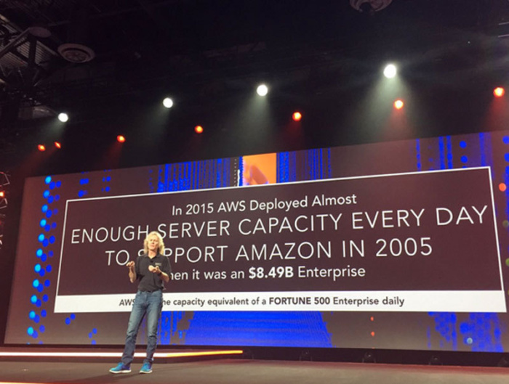
Background: Cloud Capacity
AWS “Re:Invent 2016”

Slide 10
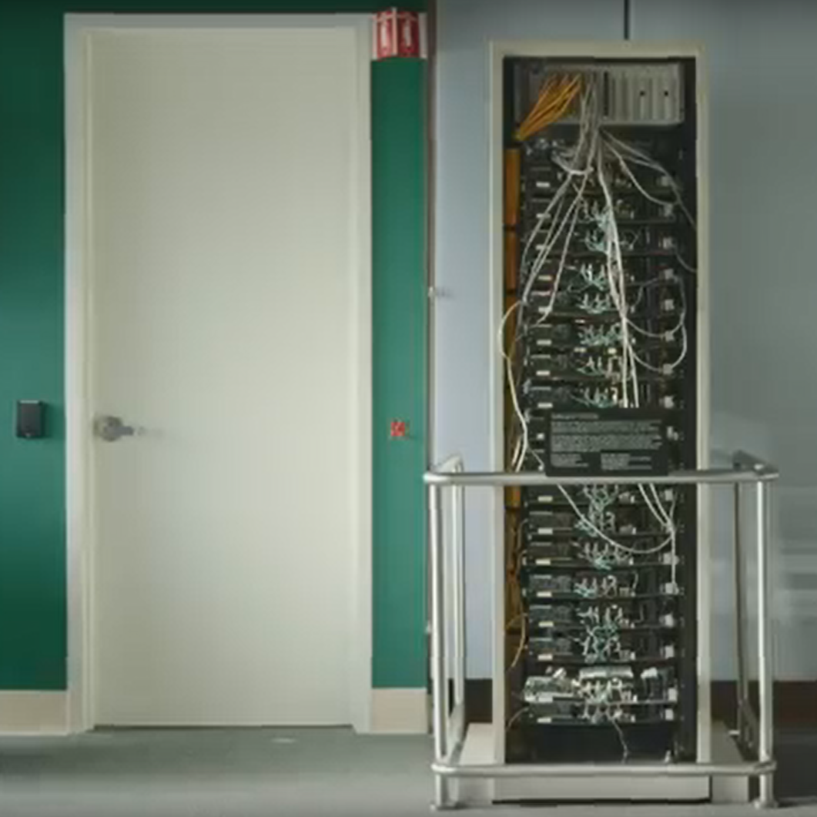
Background: Cloud Capacity
Google Origins

Slide 11
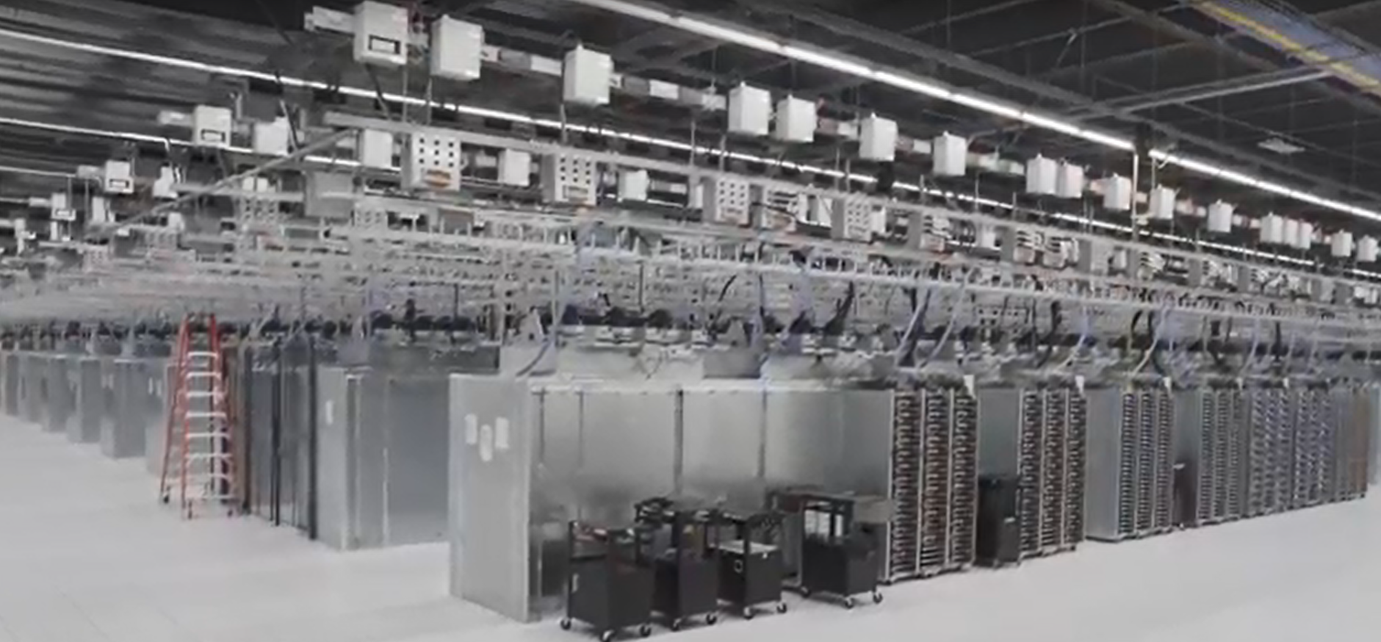
Background: Cloud Capacity
Google Datacentre

Slide 12
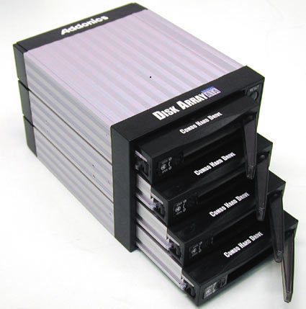
Background: Disk Arrays
A disk array consists of:
Multiple disks
Extra controlling mechanisms
Cache, etc.
A disk array is used because:
Single disks are slow
Faults/errors can (will) happen

Slide 13
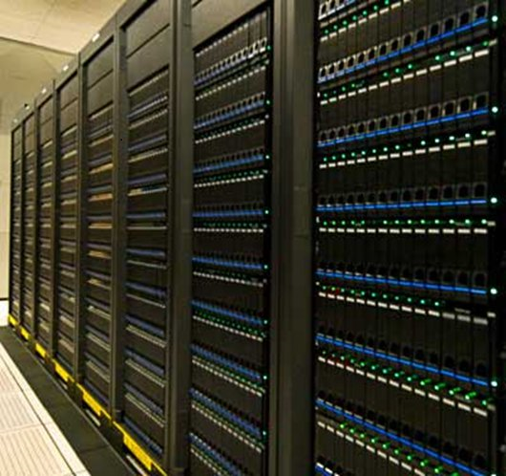
Background: Disk Arrays
Clusters of Disk Arrays are used by large cloud providers

Slide 14
Basic Concepts
Mortality Rate
Durability
Redundancy
RAID Levels
DAS
NAS
SAN

Slide 15
Basic Concepts: Mortality Rate
Failures happen
Things break in a moderately predictable way
Relative Mortality Rate
FAILURE RATE
100
80
60
40
20
TIME

Slide 16
Basic Concepts: Durability
Durability (not loosing data) is critically important.
Amazon S3 is designed for:
99.999999999% durability, and
99.99% availability over a given year
But, with a capacity of 10 EB and a durability of 99.999999999%, 100 MB are lost annually.
https://aws.amazon.com/s3/storage-classes/

Slide 17
Basic Concepts: Redundancy
Redundancy is a solution to the fault tolerance problem of disks
Redundancy can come in two forms:
Complete Redundancy (Copies)
Partial Redundancy

Slide 18
Basic Concepts: Redundancy
Complete copies
Replication, aka mirroring
Mirrored Copies

Slide 19
Basic Concepts: Partial Redundancy
Error Correcting Codes (ECC)
Detect errors
Correct errors
Hamming codes
Data bits + Parity bits = Total bits

Slide 20
Basic Concepts: Partial Redundancy
Parity
Exclusive-Or data blocks to calculate a parity block
Any data block can be re-constructed from the other blocks + parity block
XOR
Parity Unit (XOR of the rest of stripe units in same stripe)

Slide 21
Basic Concepts: Redundancy: Advantages
Individual disks
Originally, these were among the most unreliable components in a system
Now, these are one of the most reliable ones
Annual Failure Rate (AFR) is 1 to 2%
Multiple disks
AFR increases with more disks
but overall decreases with redundancy

Slide 22
Basic Concepts: Redundancy: Disadvantages
Cost
Replicating everything costs 2x as much
Solution – partial redundancy
Slower updates
2x as many copies to write
Even worse with partial redundancy
Greater complexity
80-90% of disk array firmware is error handling
Lots and lots of configuration choices …

Slide 23
Basic Concepts: RAID levels
RAID = Redundant Array of Inexpensive Disks
Currently accepted RAID levels:
0 : no redundancy striping (just a bunch of disks JBOD)
1 : full copy (mirroring)
10 (said one-zero) : striped mirrors
2 : bit level striping, Hamming-codes / ECC (not used)
3 : byte-interleaved parity
4 : block interleaved parity (more useful variant of RAID3)
5 : rotated block-interleaved parity
6 : double parity (rare)

Slide 24
Basic Concepts: RAID Level 5
RAID 5: rotated parity striping to balance the load
Updating parity is expensive for small writes
Algorithm
Read old data (2 I/Os)
Compute new parity using XOR
Write new data & parity (2 I/Os)
Therefore, 4 I/O operations per small write
new data to be written
2
XOR
1
old data to be over-written
3
3
Stripe
Parity Unit
Data Units

Slide 25
Basic Concepts: RAID Level 5
RAID 5: recovering data after a disk failure
Disk Failure
Recovery
XOR
write
XOR
write
XOR
write
XOR
write
Working Disk
Working Disk
Working Disk
New Disk

Slide 26
Basic Concepts: Hosts, Networks and Storage
How do hosts/servers connect to disks/arrays?
Three common methods:
Direct Attached Storage → DAS
Network Attached Storage → NAS
Storage Area Networks → SAN

Slide 27
Basic Concepts: Direct Attached Storage (DAS)
Most well known, used in your PC
Uses common/well used protocols:
IDE: simple general purpose bus system
SCSI: higher capacity bus
Well known protocols… bus oriented…
But DAS makes it difficult to share data

Slide 28
Basic Concepts: Network Attached Storage (NAS)
Special purpose built file server
Windows or Linux OS foundation
Provides nothing but files … no other services
Benefits:
Aggregates blocks from multiple disks
Layout and caching can be optimised
Finer grained protection can be achieved
Enables HTTP like protocols access to files

Slide 29
Basic Concepts: Network Attached Storage (NAS)
Disadvantages:
Performance? Another ‘thing’ in the way of data and application
Limitations on size of storage

Slide 30
Basic Concepts: Storage Area Networks (SAN)
Do you remember the SAN on the lab topologies?

Slide 31
Basic Concepts: Storage Area Networks (SAN)
Blocks are primary unit of data
Dedicated network … used primarily for storage
Benefits:
High Performance and reliability
Flexibility – many configurations … disks, arrays, hosts, tapes
No limits (or extremely large) on storage amount
Disadvantages:
Cost … specialised networks and interfaces…

Slide 32
Summary
Background
Cloud Deployment Models
Hierarchy
Cloud Capacity
Disk Arrays
Basic Concepts
Mortality
Durability
Redundancy
RAID Levels
DAS
NAS
SAN

